Slide 1
RELATIONAL MODELS

Slide 2
ONE TO MANY
& COMPOSITION

Slide 3
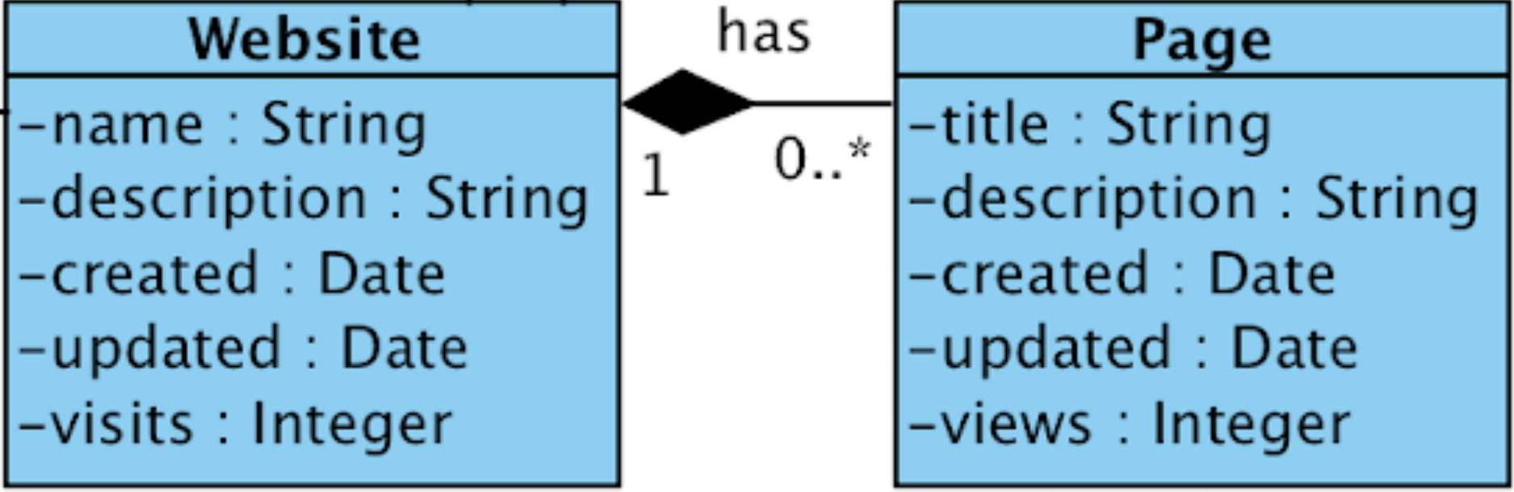
websites have pages
One to many relationships define "has a" relation
Consider the following classes; websites first

Slide 4
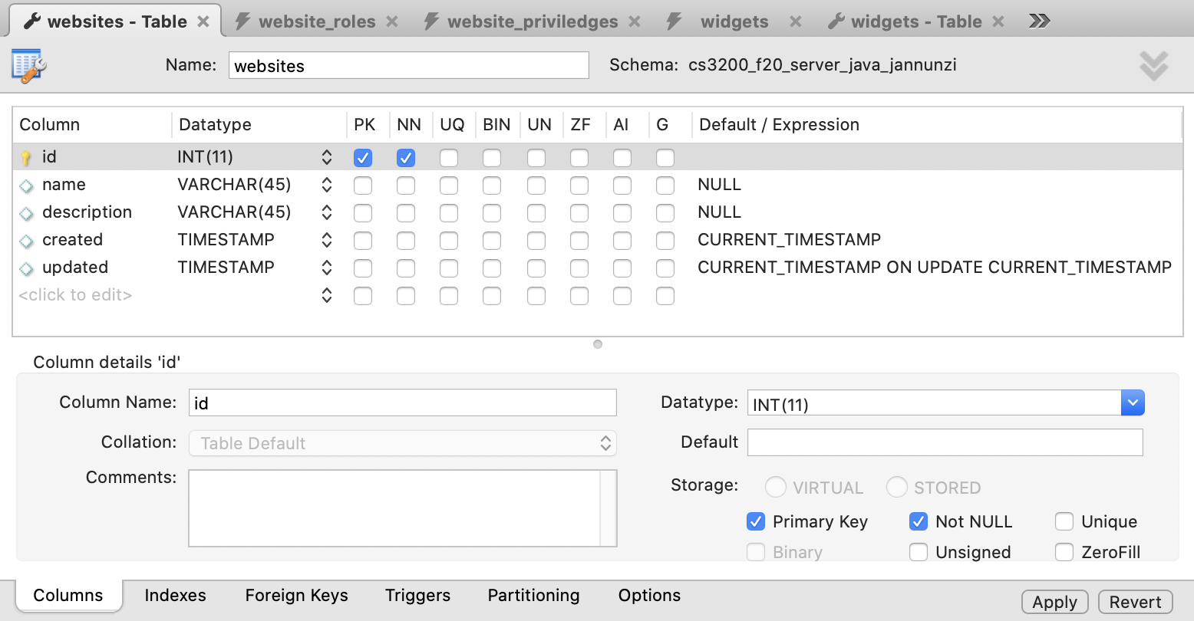
create table websites
created and updated fields allow auditing
default current_timestamp and on update current_timetamp define and update the field's value

Slide 5
create table websites
CREATE TABLE `websites` (
`id` int(11) NOT NULL,
`name` varchar(45) DEFAULT NULL,
`description` varchar(45) DEFAULT NULL,
`created` timestamp NULL
DEFAULT CURRENT_TIMESTAMP,
`updated` timestamp NULL
DEFAULT CURRENT_TIMESTAMP
ON UPDATE CURRENT_TIMESTAMP,
PRIMARY KEY (`id`)
);

Slide 6
insert into websites
INSERT INTO `websites` VALUES (123,'Facebook','an online ...', '2020-10-07 12:17:13','2020-10-07 12:17:13');
INSERT INTO `websites` VALUES (234,'Twitter','an online ...', '2020-10-07 12:17:13','2020-10-07 12:17:13');

Slide 7
Now let's take a look at pages
Now let's take a look at the pages
In particular: one to many and composition

Slide 8
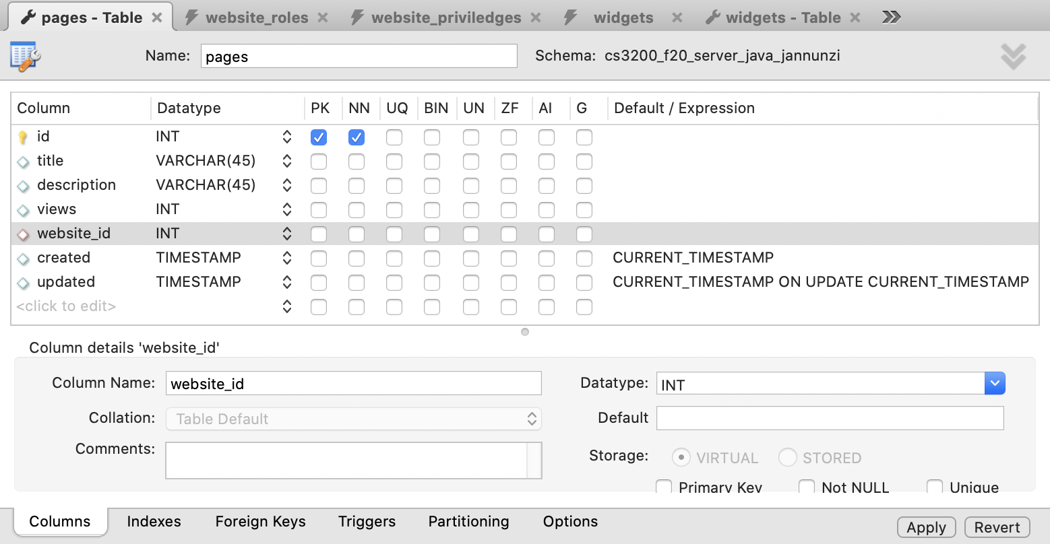
create table pages
We'll keep track of website this page belongs to

Slide 9
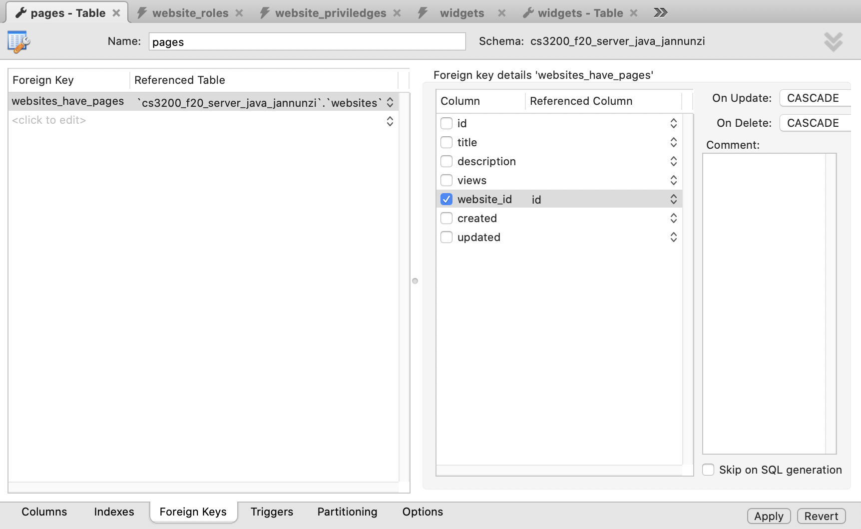
create table pages
Foreign key implements one to many
On Delete cascade implements composition

Slide 10
create table pages
CREATE TABLE `pages` (
`id` INT NOT NULL, `title` VARCHAR(45) NULL,
`description` VARCHAR(45) NULL,
`views` INT NULL, `website_id` INT NULL,
`created` TIMESTAMP NULL DEFAULT CURRENT_TIMESTAMP,
`updated` TIMESTAMP NULL DEFAULT CURRENT_TIMESTAMP
ON UPDATE CURRENT_TIMESTAMP,
PRIMARY KEY (`id`),
INDEX `websites_have_pages_idx` (`website_id` ASC),
CONSTRAINT `websites_have_pages`
FOREIGN KEY (`website_id`)
REFERENCES `cs3200_f20_server_java_jannunzi`.`websites` (`id`)
ON DELETE CASCADE
ON UPDATE CASCADE);

Slide 11
Let's create some pages for some websites
INSERT INTO `pages` VALUES ('123', 'Home', 'Landing page', '123434', '123');
INSERT INTO `pages` VALUES ('234', 'About', 'Website description', '234545', '234');

Slide 12
NORMALIZED INHERITANCE & SQL

Slide 13
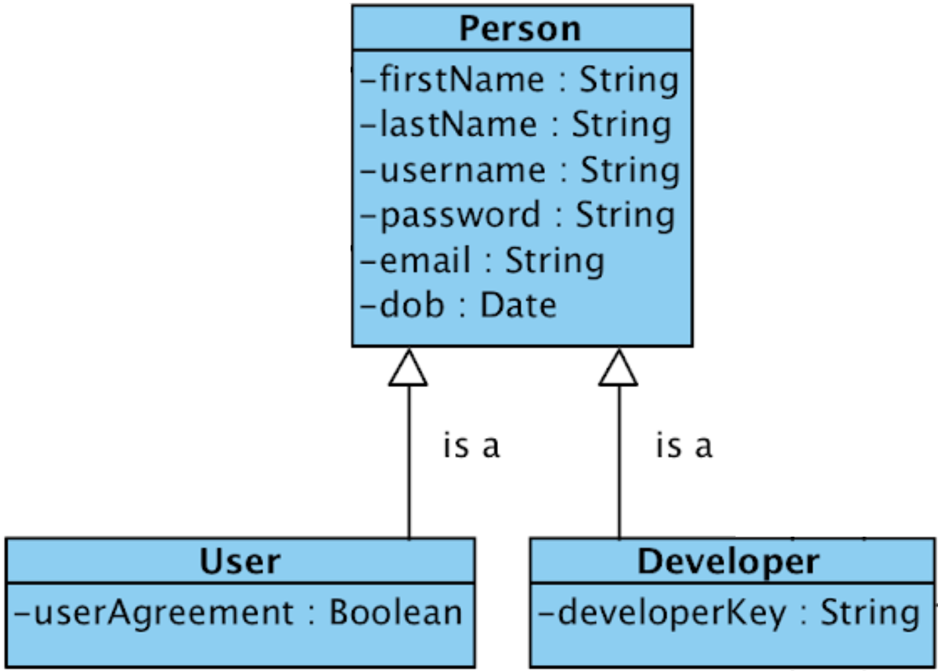
Inheritance/Specialization/Generalization
Class inheritance establishes an "is a" relationship
Derived classes are special cases
Base classes are general cases
Joined or Normalized implementation uses table per class & FK constraints

Slide 14
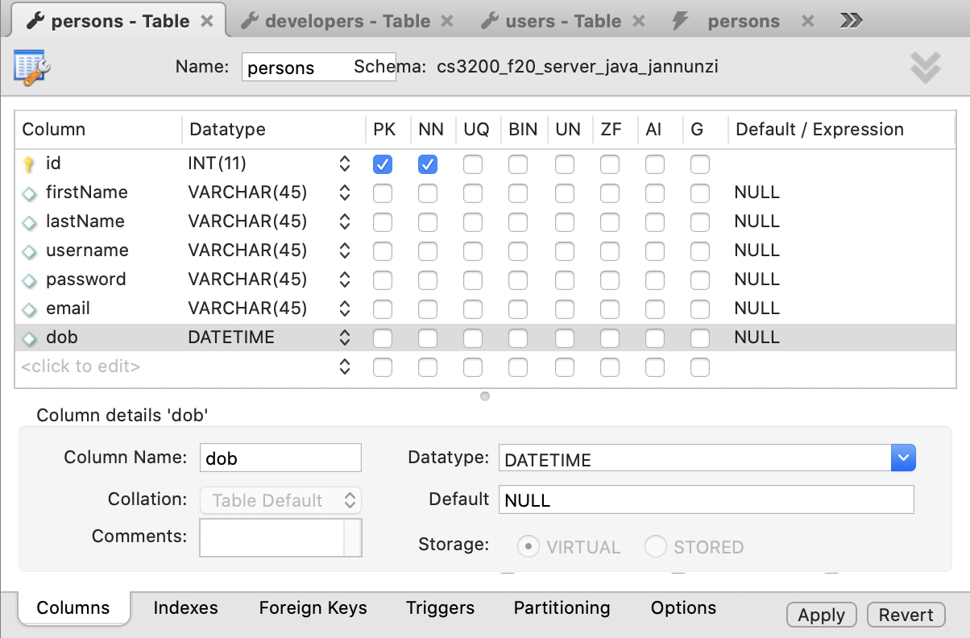
persons Table
Persons table declares fields common to all Persons
No auto_increment so we must provide IDs

Slide 15
persons Table
CREATE TABLE `persons` (
`id` int(11) NOT NULL,
`firstName` varchar(45) DEFAULT NULL,
`lastName` varchar(45) DEFAULT NULL,
`username` varchar(45) DEFAULT NULL,
`password` varchar(45) DEFAULT NULL,
`email` varchar(45) DEFAULT NULL,
`dob` datetime DEFAULT NULL,
PRIMARY KEY (`id`)
);

Slide 16
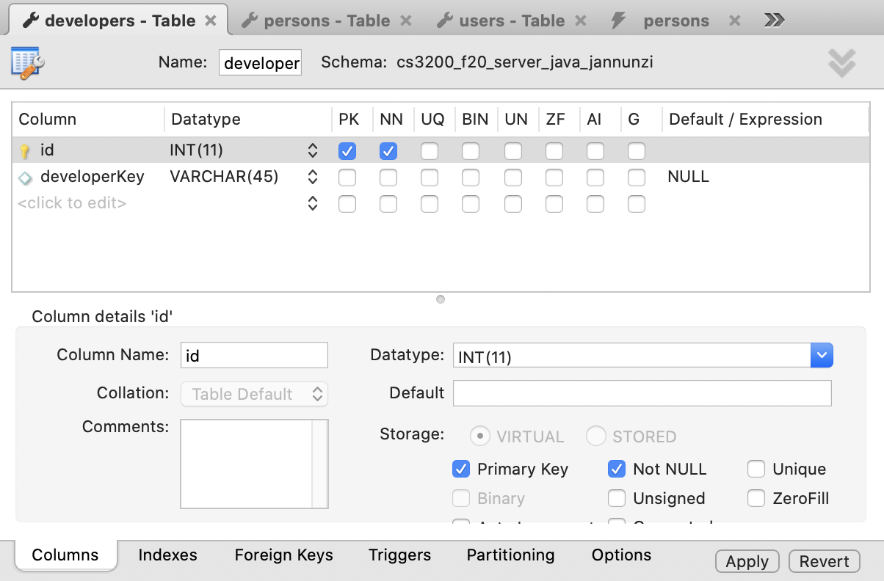
developers Table
Developers table defines fields specific to developers, e.g., developerKey

Slide 17
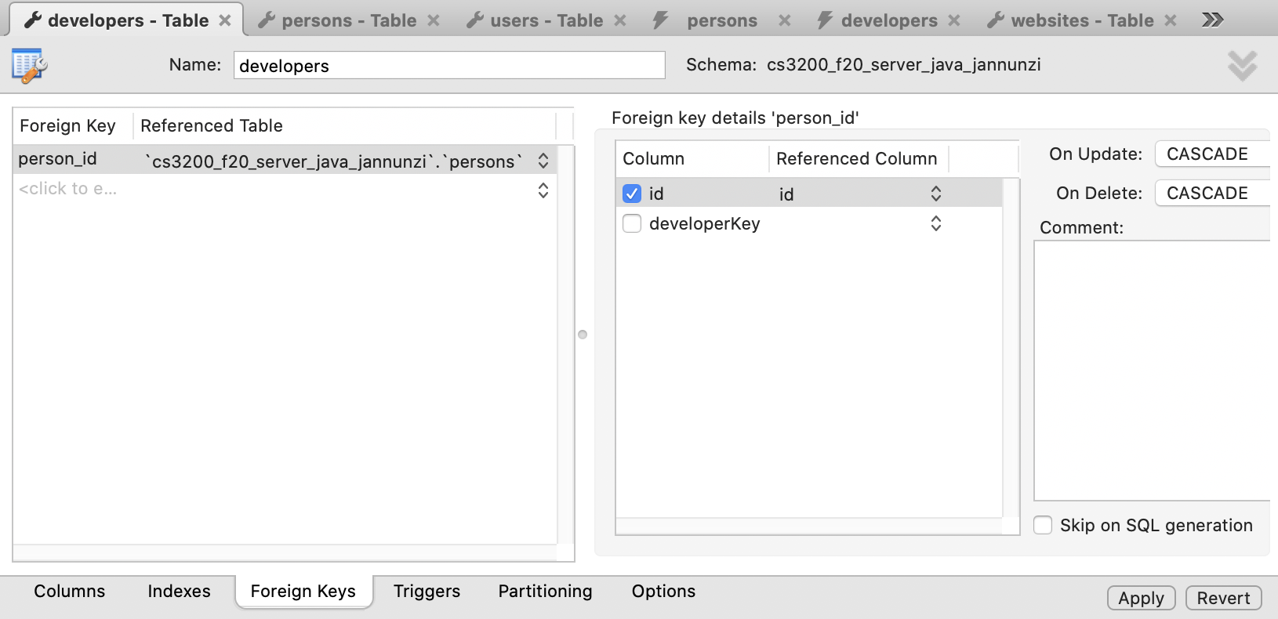
developers FK Constraints
Primary key (id) is also foreign key referencing person.id
Creates a one to one relationship between records
Cascade on Update and Delete enforces one to one dependency

Slide 18
developers Table
CREATE TABLE `developers` (
`id` int(11) NOT NULL,
`developerKey` varchar(45) DEFAULT NULL,
PRIMARY KEY (`id`),
CONSTRAINT `person_id`
FOREIGN KEY (`id`)
REFERENCES `persons` (`id`)
ON DELETE CASCADE
ON UPDATE CASCADE
);

Slide 19
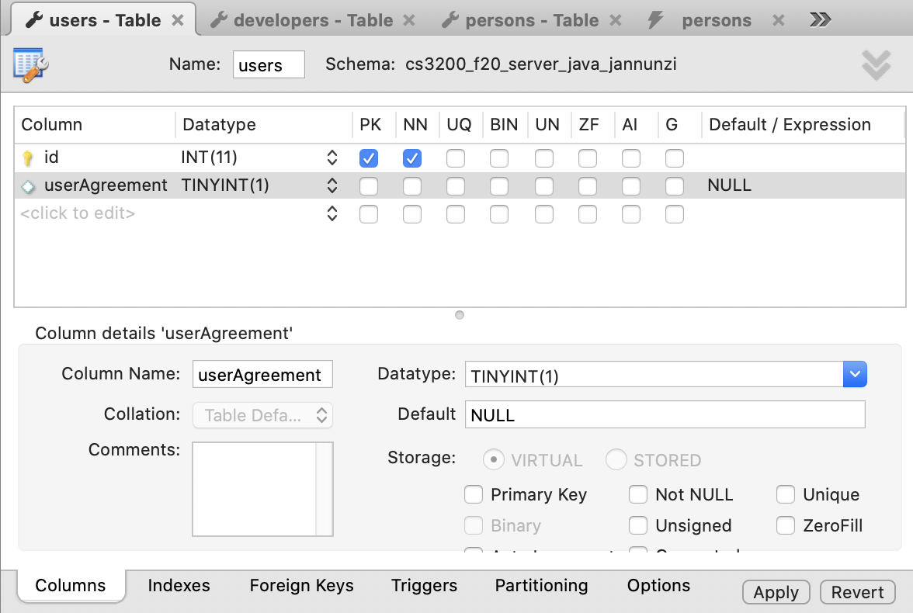
users Table
Users table defines fields specific to users, e.g., userAgreement

Slide 20
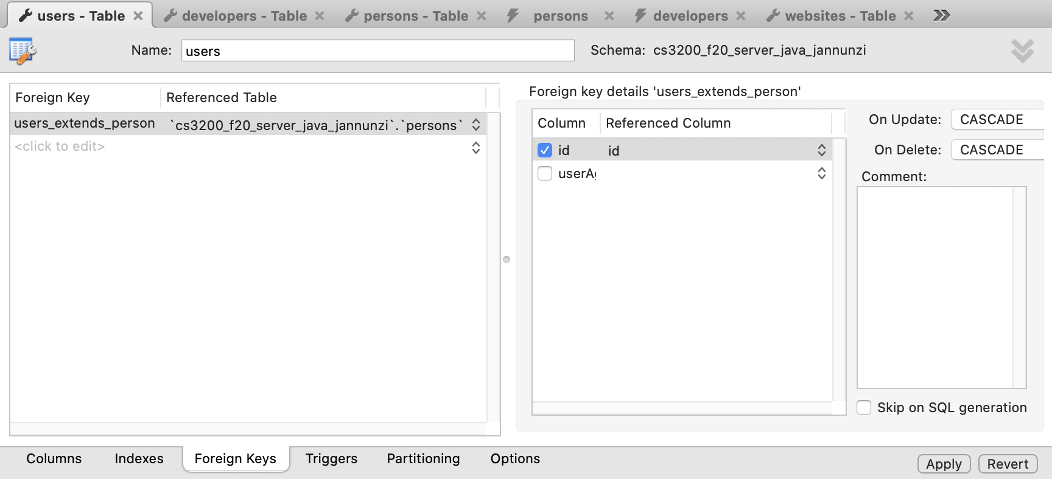
users FK Constraints
Primary key (id) is also foreign key referencing person.id
Creates a one to one relationship between records
Cascade on Update and Delete enforces one to one dependency

Slide 21
users Table
CREATE TABLE `users` (
`id` int(11) NOT NULL,
`userAgreement` tinyint(1) DEFAULT NULL,
PRIMARY KEY (`id`),
CONSTRAINT `users_extends_person`
FOREIGN KEY (`id`)
REFERENCES `persons` (`id`)
ON DELETE CASCADE
ON UPDATE CASCADE
);

Slide 22
Inserting into persons
INSERT INTO `persons`
(`id`,`firstName`,`lastName`,`username`,
`password`,`email`,`dob`) VALUES
(12,'Alice','Wonderland','alice','alice',
'alice@wonderland','2000-01-01 00:00:00');

Slide 23
Inserting into persons
INSERT INTO `persons` VALUES (23,'Bob','Marley','bob','bob','bob@marley', '2001-01-01 00:00:00');
INSERT INTO `persons` VALUES (45,'Dan','Martin','dan','dan','dan@martin.com', '1999-01-01 00:00:00');

Slide 24
Creating a developer and a user
INSERT INTO `developers` VALUES (12,'4321rewq'); -- alice
INSERT INTO `users` VALUES (45,'1'); -- dan

Slide 25
DENORMALIZED INHERITANCE & SQL

Slide 26
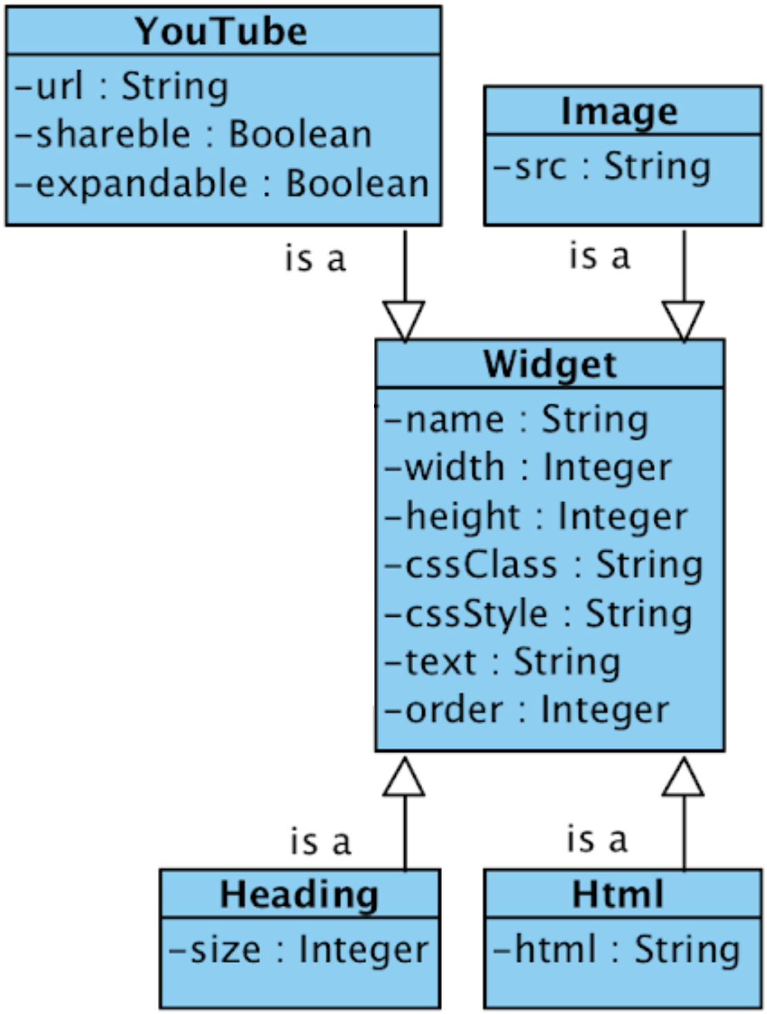
Denormalized Inheritance
Class inheritance establishes an "is a" relationship
Derived classes are special cases
Base classes are general cases
Denormalized implementation uses single table for all fields
Consider the following class diagram

Slide 27
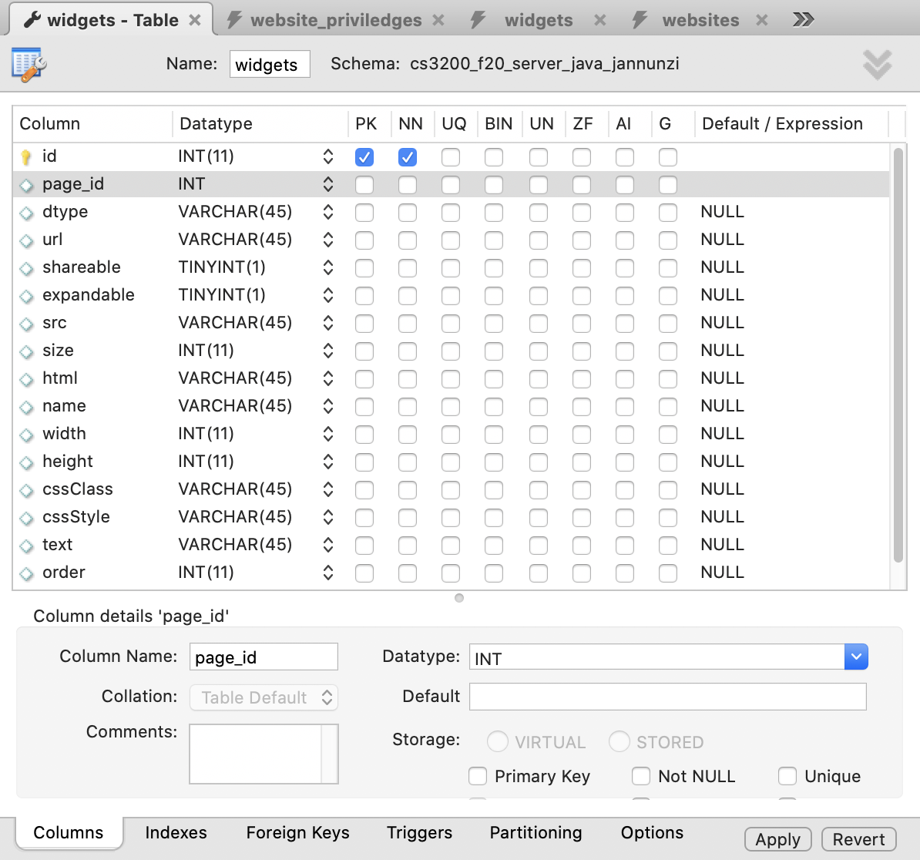
widgets Table
Declares all fields common to all derived classes
Also fields specific to derived classes
Also a "dtype" field to know which is relevant class

Slide 28
create table widgets
CREATE TABLE `widgets` (
`id` int(11) NOT NULL,
`page_id` int(11) DEFAULT NULL, `dtype` varchar(45) DEFAULT NULL,
`size` int(11) DEFAULT NULL, `width` int(11) DEFAULT NULL,
`height` int(11) DEFAULT NULL, `url` varchar(45) DEFAULT NULL,
`src` varchar(45) DEFAULT NULL, `html` varchar(45) DEFAULT NULL,
`name` varchar(45) DEFAULT NULL,`shareable` tinyint(1) DEFAULT NULL,
`expandable` tinyint(1) DEFAULT NULL,
`cssStyle` varchar(45) DEFAULT NULL,
`cssClass` varchar(45) DEFAULT NULL,
`text` varchar(45) DEFAULT NULL,
`order` int(11) DEFAULT NULL,
PRIMARY KEY (`id`));

Slide 29
Inserting widgets
INSERT INTO `widgets` VALUES ('123', '123', 'YouTube', '1', '1', 'https://youtu.be/h67VX51QXiQ', '12', 'head123', '400', '200', 'scrollable', 'resizable', 'cool video', '0');

Slide 30
PORTABLE
ENUMS

Slide 31
Denormalized Inheritance
Class inheritance establishes an "is a" relationship
Derived classes are special cases
Base classes are general cases
Denormalized implementation uses single table for all fields
Consider the following class diagram

Slide 32
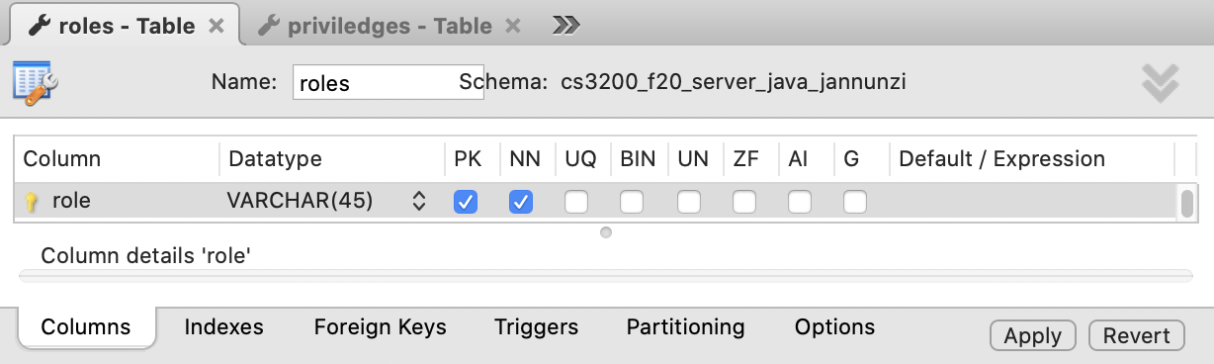
create table roles
Create a table to hold the valid values of some datatype
Here's an example of valid roles

Slide 33
create table roles
CREATE TABLE `roles` (
`role` varchar(45) NOT NULL,
PRIMARY KEY (`role`)
);

Slide 34
Insert the valid values
INSERT INTO `roles` (`role`) VALUES ('admin');
INSERT INTO `roles` (`role`) VALUES ('editor');
INSERT INTO `roles` (`role`) VALUES ('owner');
INSERT INTO `roles` (`role`) VALUES ('reviewer');
INSERT INTO `roles` (`role`) VALUES ('writer');

Slide 35
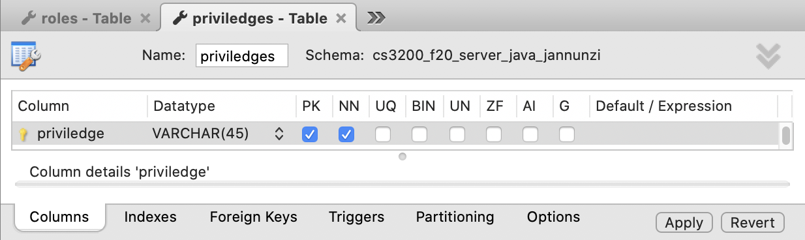
create table priviledges
Here's another example of valid priviledges

Slide 36
create table priviledges
CREATE TABLE `priviledges` (
`priviledge` varchar(45) NOT NULL,
PRIMARY KEY (`priviledge`)
);

Slide 37
Insert valid priviledges
INSERT INTO `priviledges` (`priviledge`) VALUES ('create');
INSERT INTO `priviledges` (`priviledge`) VALUES ('delete');
INSERT INTO `priviledges` (`priviledge`) VALUES ('read');
INSERT INTO `priviledges` (`priviledge`) VALUES ('update');

Slide 38
Create tables with enumerated datatypes
Now that we have enumerated datatypes, we can declare fields
Consider the following classes with priviledge and role datatypes
We can implement as foreign keys referencing our enumerated tables

Slide 39
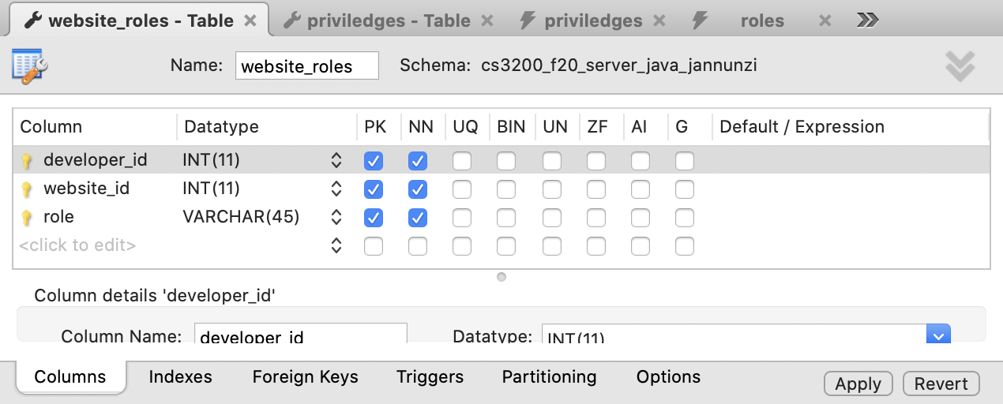
create website_roles
Constrain a field as foreign key referencing primary key of enumerated table
Field role (fk) will refer to role (pk) field in roles table

Slide 40
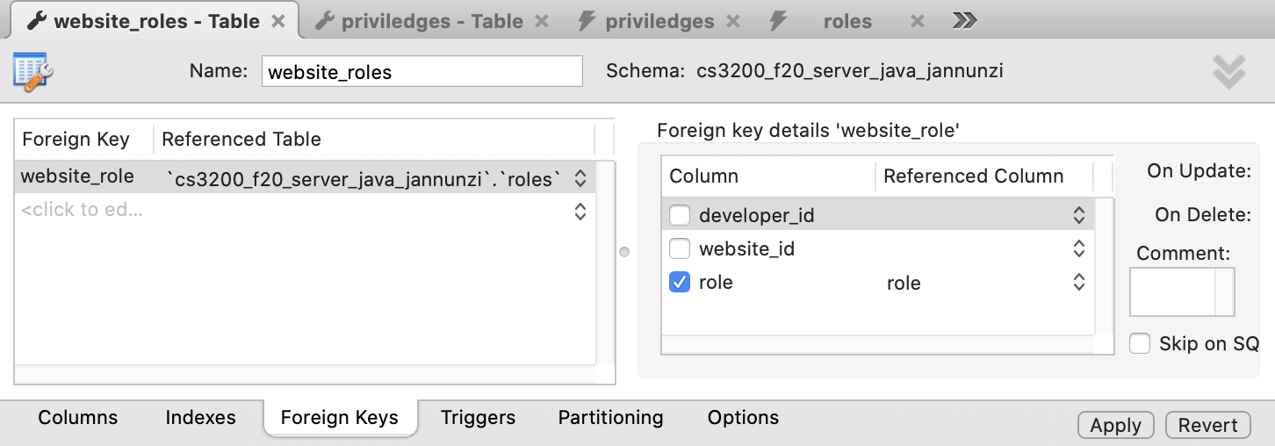
create website_roles
Constrain a field as foreign key referencing primary key of enumerated table

Slide 41
create website_priviledges
Constrain a field as foreign key referencing primary key of enumerated table
Field priviledge_id (fk) will refer to priviledge (pk) field in priviledges table

Slide 42
create website_priviledges
Constrain a field as foreign key referencing primary key of enumerated table

Slide 43
TRIGGERS

Slide 44
Triggers can respond to events
Use the following roles for the privileges:
role - priviledges
owner - create, read, update, delete
admin - create, read, update, delete
writer - create, read, update
editor - read, update
reviewer - read

Slide 46
IF NEW.role='admin' OR NEW.role='owner'
CREATE DEFINER=`root`@`localhost` TRIGGER
`website_roles_AFTER_INSERT`
AFTER INSERT ON `website_roles` FOR EACH ROW
BEGIN
IF NEW.role='admin' OR NEW.role='owner' THEN
INSERT INTO website_priviledges VALUES
(NEW.developer_id, NEW.website_id, 'create');
INSERT INTO website_priviledges VALUES
(NEW.developer_id, NEW.website_id, 'read');
INSERT INTO website_priviledges VALUES
(NEW.developer_id, NEW.website_id, 'update');
INSERT INTO website_priviledges VALUES
(NEW.developer_id, NEW.website_id, 'delete');
END IF;

Slide 47
IF NEW.role='writer'
IF NEW.role='writer' THEN
INSERT INTO website_priviledges VALUES
(NEW.developer_id, NEW.website_id, 'create');
INSERT INTO website_priviledges VALUES
(NEW.developer_id, NEW.website_id, 'read');
INSERT INTO website_priviledges VALUES
(NEW.developer_id, NEW.website_id, 'update');
END IF;

Slide 48
IF NEW.role='editor'; IF NEW.role='reviewer'
IF NEW.role='editor' THEN
INSERT INTO website_priviledges VALUES
(NEW.developer_id, NEW.website_id, 'read');
INSERT INTO website_priviledges VALUES
(NEW.developer_id, NEW.website_id, 'update');
END IF;
IF NEW.role='reviewer' THEN
INSERT INTO website_priviledges VALUES
(NEW.developer_id, NEW.website_id, 'read');
END IF;
END

Slide 49
Test by inserting roles into website_roles
INSERT INTO `website_roles` VALUES (12,123,'owner');
INSERT INTO `website_roles` VALUES (23,234,'editor');

Slide 50
Trigger makes the following inserts
INSERT INTO `website_priviledges` VALUES (12,123,'create');
INSERT INTO `website_priviledges` VALUES (12,123,'delete');
INSERT INTO `website_priviledges` VALUES (12,123,'read');
INSERT INTO `website_priviledges` VALUES (12,123,'update');

Slide 51
Trigger makes the following inserts
INSERT INTO `website_priviledges` VALUES (23,234,'update');
INSERT INTO `website_priviledges` VALUES (23,234,'read');

